Slide 1

Project Title - SEASONAL AGRICULTURE PERFORMANCE ANALYSIS
[Student Name: AR Hafiz Muhammed
College Name- Saintgits College of Engineering ]
AICTE STU ID : (STU6a6908c93b5601785268425)

Slide 2

PROBLEM STATEMENT
(Agricultural activities are influenced by seasonal variations in environmental conditions, farming practices, resource availability and market conditions. As a result, agricultural performance may differ from one season to another. However, raw agricultural data does not clearly explain how agricultural performance changes across seasons or what patterns can be observed in different seasonal conditions. The problem is to analyze the given agricultural dataset and investigate seasonal differences in agricultural performance by identifying meaningful patterns, trends, relationships and variations within the available data.

Slide 3
Project Description
Seasonal Agriculture Performance Analysis is a data analytics project that studies agricultural performance using a dataset containing information about:
Crops and seasons
Farm area
Rainfall and temperature
Humidity and sunlight
Soil characteristics
Fertilizer and pesticide usage
Irrigation methods
Crop yield and production
Revenue, cost and profit
Water usage and efficiency
Disease and pest risk
The project uses Python and data visualization techniques to clean, analyze and visualize the dataset.
The analysis focuses on identifying seasonal differences, crop performance, profitability, resource efficiency and relationships between agricultural factors.

Slide 4
WHO ARE THE END USERS?
Farmers
Compare crop performance across seasons.
Understand resource usage and profitability.
Agricultural Planners
Identify seasonal agricultural patterns.
Support planning and resource allocation.
Agricultural Researchers
Study relationships between environmental and farming factors.
Government / Agricultural Departments
Support data-driven agricultural planning and decision-making.
Agribusinesses
Understand crop profitability, production and market-related patterns.

Slide 5

Technology Used
  Programming Language
  Python
  Development Environment
  Google Colab
  Libraries
  Pandas
  NumPy
  Matplotlib
  Seaborn
  Analysis Techniques
  Data Cleaning
  Descriptive Statistics
  GroupBy Analysis
  Univariate Analysis
  Bivariate Analysis
  Multivariate Analysis
  Correlation Analysis
  Outlier Detection
  Comparative Analysis

Slide 6
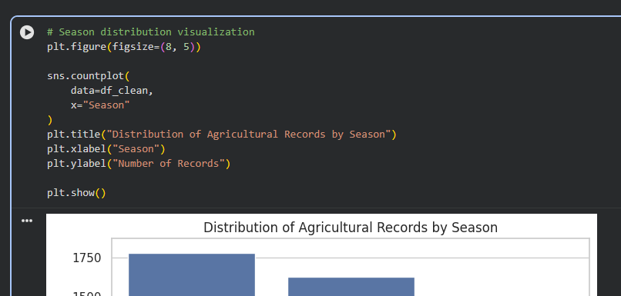
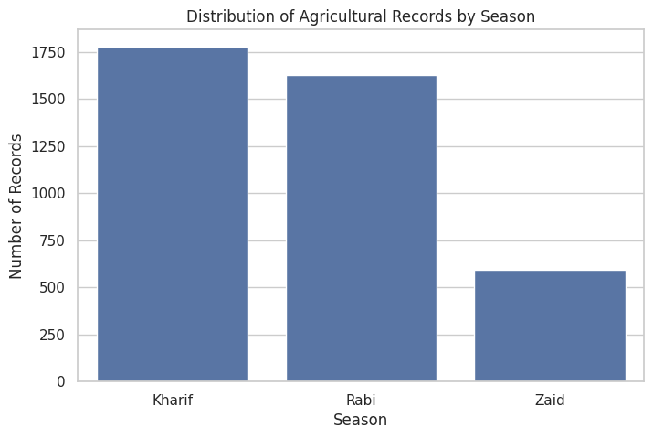
RESULTS

Slide 7
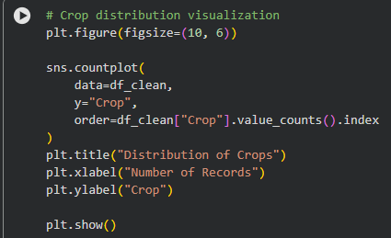
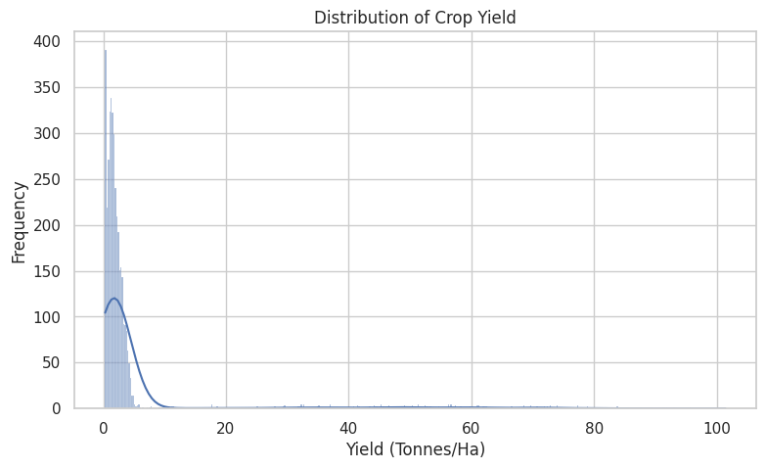
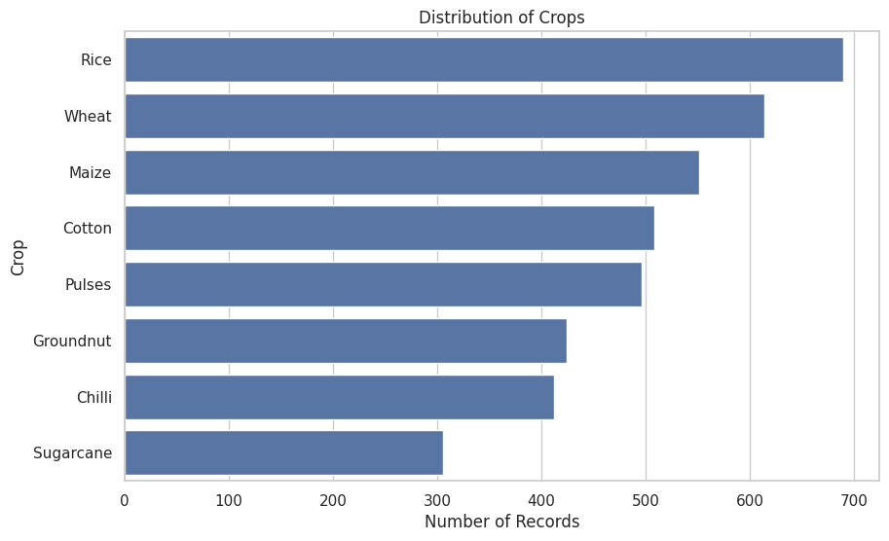
RESULTS

Slide 8
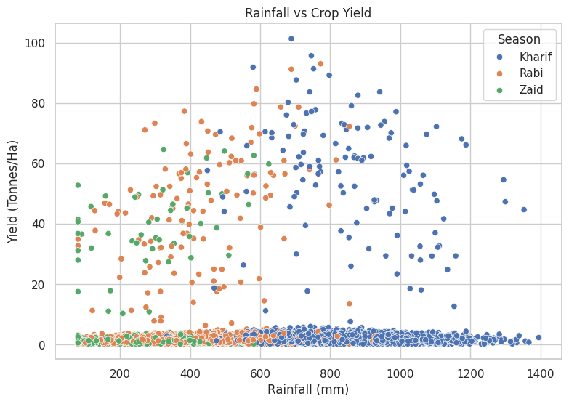
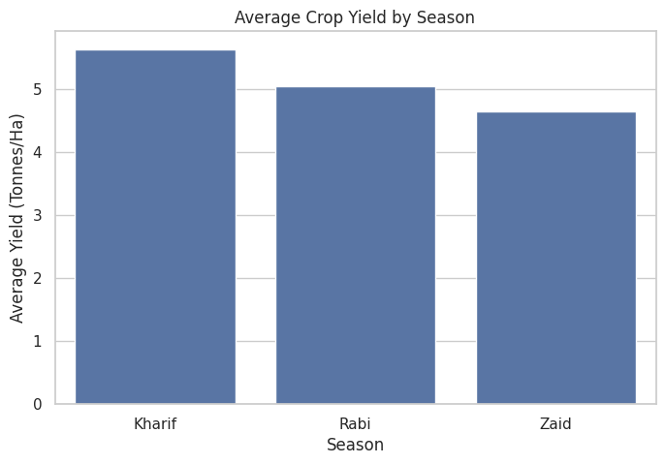
RESULTS

Slide 9
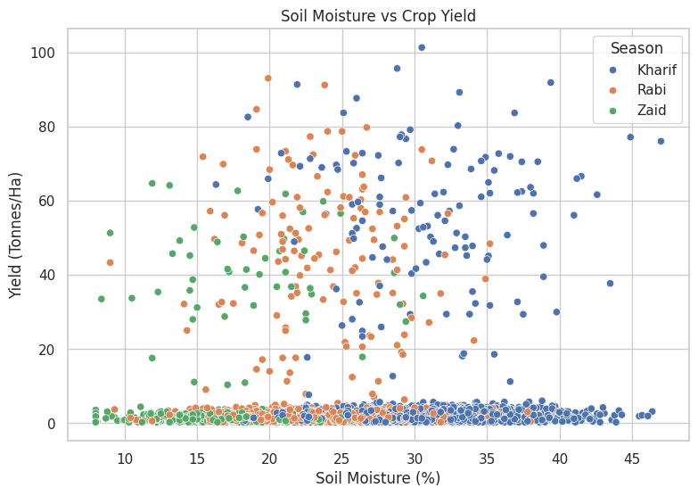
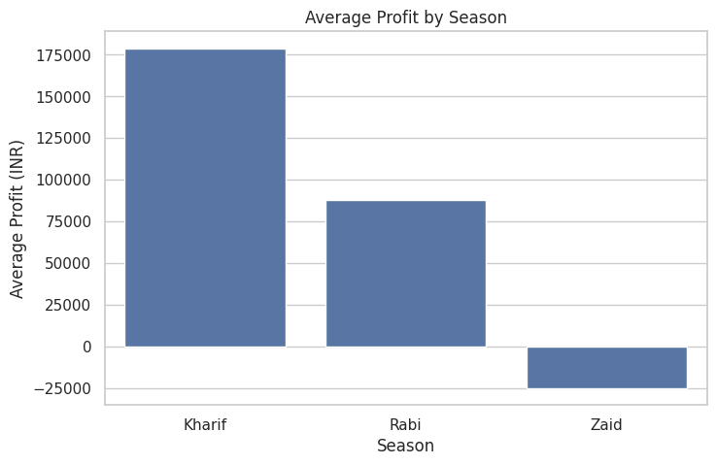
RESULTS

Slide 10
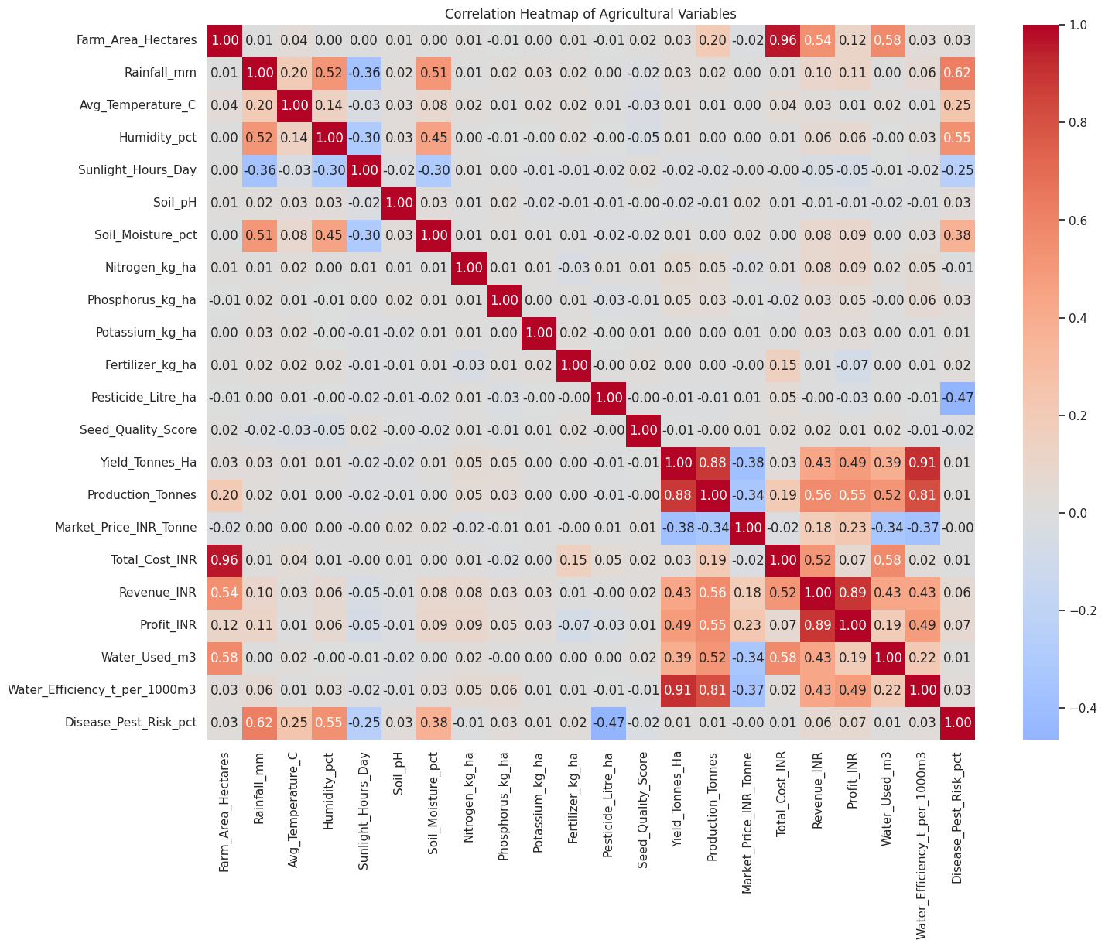
RESULTS

Slide 11
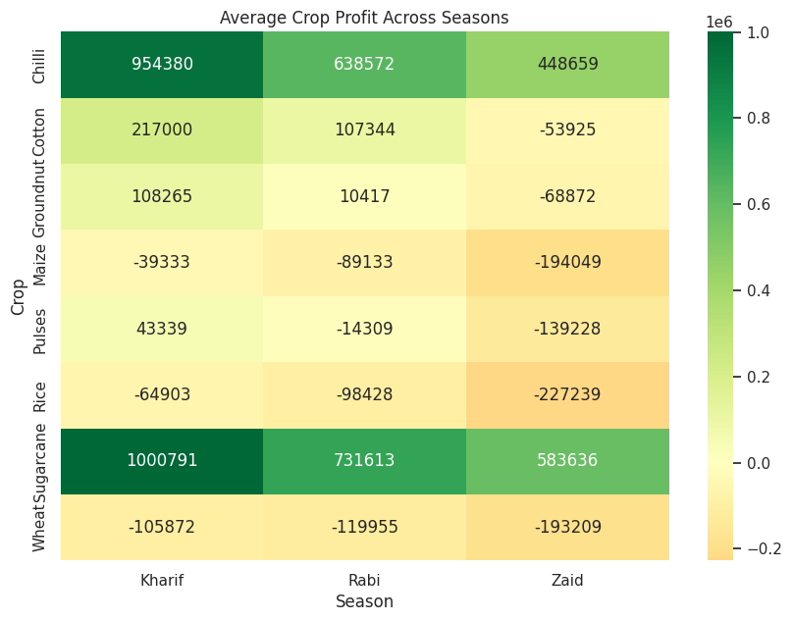
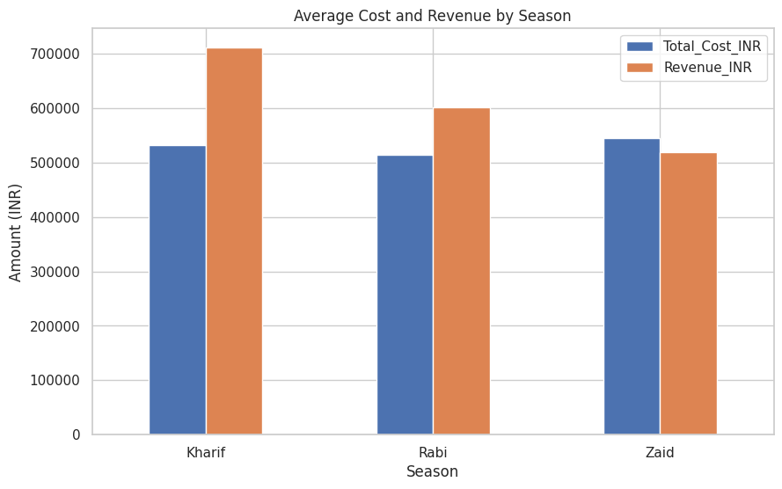
RESULTS

Slide 12
Future scope
The project can be extended by:
Developing a crop-yield prediction model
Predicting agricultural profitability
Building an interactive Power BI / Tableau dashboard
Adding real-time weather information
Adding geographical/map-based analysis
Developing seasonal crop recommendation systems
Using machine learning for disease/pest prediction
Forecasting market prices
Creating an automated agricultural decision-support system

Slide 13
GitHub Link
https://github.com/hafiz-mhd/Seasonal-Agriculture-Performance-Analysis.git

Slide 14

VOIS Course completion certificate -
Course name- Data Visualization

Slide 15
Thank you
AR Hafiz Muhammed
.
.

